Slide 1
Behavioral Health (ABA) Treatment Overview, Authorization & Claims Training
July 2022
Notes:
Welcome and thank you for joining us today for our Behavioral Health (ABA) Treatment Overview, Authorization & Claims Training where we will review upcoming changes to your ABA contract regarding HCPCS codes and modifiers and the claims and authorization procedures associated.
My name is Elizabeth Ginder and I am the Sr. Network Trainer here at CenCal Health and I will be your host throughout this training. <DETERMINE BEST APPROACH FOR INTROS>
We are recording this training for future reference and you will receive a copy of the recording in the next couple of days. In addition, we have included these slides as a handout in the training platform along with additional resources that are available to download right now.

Slide 2
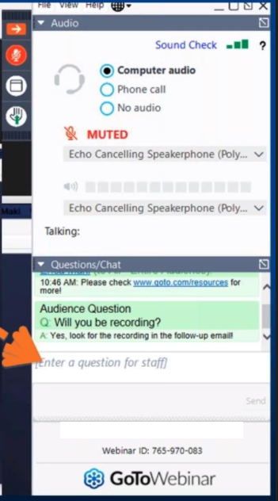
Housekeeping
Submit questions via questions pane
Notes:
Now Before we get started I would like to go over a few house keeping items so you know how to participate in this event, you should see an attendee control pane on your screen, and you will have the opportunity to submit questions by typing into the question panel at any time, all of your audio is on mute so if you have questions or concerns please use the questions tool. Our team will leave time at the end to address any of your questions that you enter throughout the event during Q&A.

Slide 3
Review the Behavioral Health (ABA) Treatment Benefit & Referrals
Andy, Behavioral Health Care Manage
FBA & Progress Reports, & Authorizations
Martha, Behavioral Health Care Manager
Provider Responsibilities
Clara, Clinical Support Associate
Claims & Billing
Lucy, Claims Provider Data Configuration Analyst
Language Interpreter Services
Elizabeth, Senior Provider Trainer
Q&A
Agenda
Notes:
<LIZ TO UPDATE SLIDE>
Our objectives of this presentation are to provide a review of the mental health benefit, behavioral health department required Provider forms, Provider clinical standards, referrals, authorizations and claims/billing.
Now I would like to introduce you to our panel of experts today. First we have Dr. Bowers who will present on xxx
- Our Claims Configuration Analyst, Lucy Renteria who will speak about mental health procedure codes for claims & billing
- Anna McNeil, another Provider Services Representative who will present on cultural & linguistic language assistance resources
- And then we will follow-up with Q&A for anyone that would like additional clarification on topics mentioned today.

Slide 4
Review the Behavioral Health (ABA) Treatment Benefit & Referrals
FBA & Progress Reports, & Authorizations
Provider Responsibilities
Claims & Billing
Language Interpreter Services
Andy
Behavioral Health Care Manage
SLIDE HEADLINE
Second level of text
Notes:
Let’s start with reviewing the BHT Benefit. (Andy)

Slide 5
Eligibility for BHT services
Reminder:
CenCal Health covered BHT services do not address behaviors affecting the member’s functioning primarily in the academic setting
The Member must be:
Under 21 years of age
Medically stable
Not in need of 24 hour medical/nursing monitoring provided in a hospital or ICF.
ABA Treatment must be recommended by a physician, psychologist or surgeon on CenCal Health’s ABA Referral form.
The Member must be presenting with a pattern of developmentally inappropriate behaviors that is significantly affecting their ability to function across different systems
The Member’s behaviors are not a result of an untreated medical condition, sensory impairment or mental health disorder that can be treated with another modality.
Notes:
(Andy) CenCal Members may be eligible for BHT services if they meet the following criteria:
The Member must be:
under 21 years of age
Medically stable
Not in need of 24 hour medical/nursing monitoring provided in a hospital or ICF.
ABA Treatment must be recommended by a physician, psychologist or surgeon on CenCal’s ABA Referral form.
The Member must be presenting with a pattern of developmentally inappropriate behaviors that is significantly affecting their ability to function across different systems
The Member’s behaviors are not a result of an untreated medical condition, sensory impairment or mental health disorder that can be treated with another modality.

Slide 6
Medical Necessity Criteria
Services are Medically Necessary when:
Indicated
Appropriate
Efficacious-at the initiation of treatment
Efficient
Effective-at the continuation/renewal of treatment authorizations
CenCal Health’s Clinical Guidelines indicate that services are medically necessary when:
Member’s behaviors are moderate to severe and across multiple domains and impair their functioning
Member can participate safely in Outpatient care and are not a risk to self or others.
Notes:
(Andy) ABA treatment must be medically necessary for members.
Services are Medically Necessary when:
Indicated
Appropriate
Efficacious-at the initiation of treatment
Efficient
Effective-at the continuation/renewal of treatment authorizations
CenCal’s Clinical Guidelines indicate that services are medically necessary when:
Behaviors are moderate to severe and across multiple domains and impair functioning
Member can participate in Outpatient care safely and not a “risk to self or others.”

Slide 7
Services Are Not Covered Under the following Conditions
When there are no continued clinical benefit expected.
When services occur for Respite
When services occur in day care or in a non-conventional settings such as camps, resorts, or spas.
When services for Custodial care such as
Service to maintain the client or anyone else’s safety
Treatment that is solely vocationally or recreationally based
Services that are not supported by industry standards or national guidelines.
Notes:
(Andy) Services are not covered under the following conditions:
When there is no continued clinical benefit expected.
Respite, day care or services in non-conventional settings such as camps, resorts, or spas.
Custodial care
Service is primarily to maintain the client or anyone else’s safety
Treatment that is solely vocationally or recreationally based
Services that are not evidence-based behavioral intervention practices as supported by industry standards or national guidelines.
Again, we will no longer be approving services in the camp setting

Slide 8
Updated ABA Referral Process
Eligible Recommending Providers include Physicians, Psychologists, Psychiatrists, or Surgeons will submit an ABA referral to the BH Department on the ABA Referral Form
The Recommending Provider and Member will identify their ABA provider of choice
The referral authorization is good for a 6-month period
ABA providers can submit an ABA referral on behalf of a qualified provider.
Additional information may be needed from the recommending provider, our team will outreach recommending provider.
A denial will only be issued to member and recommending provider.
Notes:
(Andy) Let’s review the referral process.
(Andy) As of 8/15, our new referral process will include any qualified provider submitting an ABA referral to CenCal’s BH Department.
Eligible Providers (Physician, Psychologist, or Surgeon)will submit an ABA referral to the BH Department
Provider or Member will identify their provider of choice
The referral authorization will be requested for a 6-month period
ABA providers can submit ABA referral on behalf of a physician or provider
Please be mindful that additional information may be needed from referring provider, out team will outreach the referring provider for this information
A denial will only be issued to member and referring provider.

Slide 9
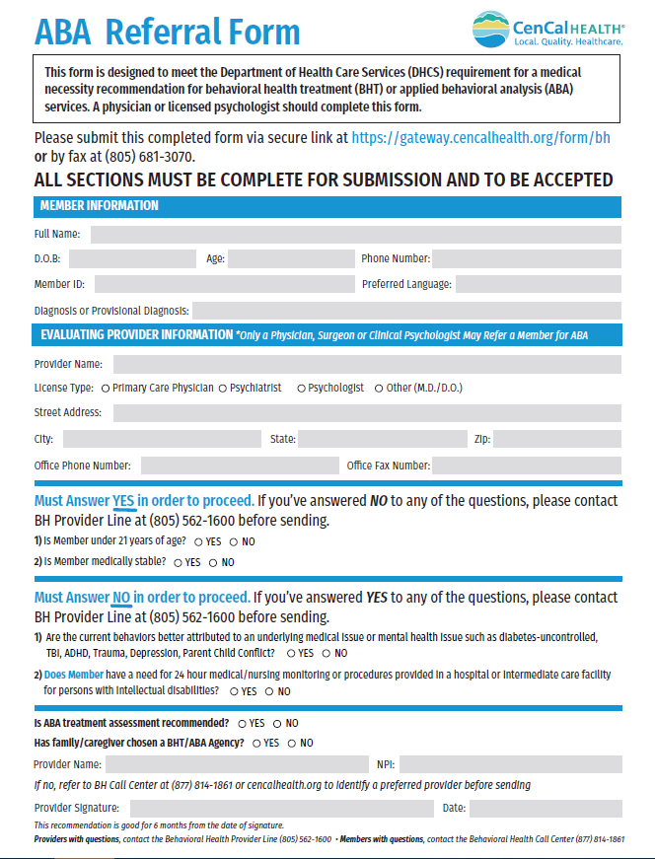
Referral Form & Processing
CenCal Health will review and provide a status determination on all authorizations within 5 business days
For treatment plans that do not include the minimum required information, the provider can request a delay.
A delay notification will be issued that allows up to 14, no more than 28 days for a decision to be made.
This will provide additional time to submit the required information
Need to add our online resource reference link
Notes:
(Andy) This is our new ABA Referral form, all fields must be complete and marked correct (yes, when a yes is required and a no, when no required) to proceed. <LIZ TO CLICK ANIMATION 2 TIMES>
We also request the provider signature.
ABA providers can work directly with a physician to obtain but will not receive a denial letter if not approved, only the member and referring provider will receive in accordance with DHCS regulatory standards.
(Andy) The Behavioral Health Department will review and provide a determination within 5 business days.
For treatment plans that do not include all the minimum required information, the provider can request a delay. A delay notification will be issued that allows up to 14, no more than 28 days for a decision to be made.

Slide 10
Referral Form & Processing (continued)
Upon approval of the referral, please reach out the member within 10 business days to offer an appointment.
If you are unable to contact the member after 2 attempts, please contact the Referring Provider or PCP to inform them of the appointment attempt.
A member’s PCP can be located within the Eligibility Screen of the Provider Portal
If member requests to be re-directed to a different provider, please refer to Referring Provider or PCP to submit a new request for a new provider.
If you are unable to provide care due to availability or member’s schedule, please contact referring provider or PCP to inform them. Referring provider or PCP will submit new request with a new provider as necessary from our Provider Directory.
Notes:
(Andy) Upon approval of the referral, please reach out to member within 10 business days to offer an appointment.
If you are unable to contact the member after 2 attempts, please contact the Referring Provider or PCP to inform.
If member requests to be re-directed to a different provider, please refer to Referring Provider or PCP to submit a new request for a new provider.
If you are unable to provide care due to availability or member’s schedule, please contact referring provider or PCP to inform. Referring provider or PCP will submit new request with new provider.

Slide 11
Initial Treatment Authorization Request for an FBA
Once a referral is received, the ABA provider is required to submit a Treatment Authorization Request (TAR) requesting up to 10 hours (H0031) for an FBA.
The authorization period is 60 days
Approved TAR’s are available for providers to print through the Provider Portal.
Authorization extensions should be sent directly to BH department
Reference original authorization
Extensions will be for 60 additional days
Requests for more than 10 hours will be reviewed for medical necessity and clinical appropriateness.
Please send clinical justification with authorization request via fax # or uploaded within the Provider Portal Authorization Request
Notes:
(Andy) Once a referral is received, the ABA provider is required to submit a Treatment Authorization Request (TAR) requesting up to 10 hours (H0031) for an FBA.
The authorization period is 60 days
Approved TAR’s are available for providers to print through the Provider Portal.
Authorization extensions should be sent directly to BH department
Reference original authorization
Extensions will be for 60 additional days
Requests for more than 10 hours will be reviewed for medical necessity and clinical appropriateness.
Please send clinical justification with authorization request
I’ll now transition to Martha

Slide 12
Review the Behavioral Health (ABA) Treatment Benefit & Referrals
FBA & Progress Reports, & Authorizations
Provider Responsibilities
Claims & Billing
Language Interpreter Services
Martha
Behavioral Health Care Manage
SLIDE HEADLINE
Second level of text
Notes:
Martha Thank you Andy, lets review Authorization Requests.

Slide 13
FBA and Progress Report Requirements
Minimum Requirements of all FBA’s (APL19-014)
Must include:
A description of the Member’s Information-reason for the referral, brief background of information, demographics, the living situation, health and medical information, school information, home information including current services and activities.
A Clinical Interview
A Standardized Assessment
The assessment procedures and results
The use of evidenced based BHT services that are described in procedures
Indicate the Member’s availability for BHT services-include the consideration of school attendance, parent availability, activities, and required schooling if home schooled.
Notes:
Martha
We will now review the minimum requirements of all FBA’s as outlined in DHCS All Plan Letter 19-014.
All FBA’s and Progress Reports must include:
A description of the Member Information (reason for referral, brief background information, demographics, living situation, health and medical information, school information, home information including current services and activities)
A clinical Interview
A Standardized Assessment-CenCal Requires one every review period
Assessment procedures and results
Use of evidenced based BHT services that are described in procedures
Indicate member availability for BHT services (include consideration of school attendance, parent availability, activities, and required schooling if home schooled).

Slide 14
FBA and Progress Report Requirements (continued)
Clearly show individualized, specific, measurable goals and objectives with DATES of when goals are anticipated to be met.
Short term goals with dates*must be clearly labeled “Short Term Goals”
Intermediate goals with dates*must be clearly labeled “Intermediate Goals”
Long term goals with dates*must be clearly labeled “Long Term Goals”
Outcome measurement assessment criteria must be clearly stated to measure achievement of behavioral objectives (Should not be copied and pasted).
Indicate the current level of baseline, the behavior that parent is expected to demonstrate including condition under which it must be demonstrated and the mastery criteria.
Include Date of introduction ▪ Include Specific plan for generalization
Include estimated date of mastery ▪ Include Progress
Indicate any revised or new goals
Notes:
Martha
Clearly show individualized, specific, measurable goals and objectives with DATES of when goals are anticipated to be met.
Short term goals with dates*must be clearly labeled “Short Term Goals”
Intermediate goals with dates*must be clearly labeled “Intermediate Goals”
Long term goals with dates*must be clearly labeled “Long Term Goals”
Outcome measurement assessment criteria must be clearly stated to measure achievement of behavioral objectives (Should not be copied and pasted).
Indicate current level of baseline, behavior parent is expected to demonstrate including condition under which it must be demonstrated and mastery criteria.
Include Date of introduction ▪ Include Specific plan for generalization
Include estimated date of mastery ▪ Include Progress
Indicate any revised or new goals

Slide 15
FBA and Progress Report Requirements (continued)
The Provider must use evidence based BHT services according to National ABA Guidelines and Industry Standards
The Treatment Plan clearly identifies:
The service type
The number of hours to direct care services
Observation
Direction
Parent/guardian training, support and participation to achieve goals and objectives (this should align for requests for units of S5111)
Frequency at which the Member’s progress is being measured and reported for each individual BHT service provider is responsible for delivering the services
Notes:
Martha
Provider must use evidence based BHT services according to National ABA Guidelines and Industry Standards
The Treatment Plan clearly identifies:
The service type
Number of hours to directive services
Observation
Direction
Parent/guardian training, support and participation to achieve goals and objectives (this should align for requests for units of S5111)
Frequency at which the member’s progress is being measured and reported for each individual BHT service provider is responsible for delivering the services

Slide 16
FBA and Progress Report Requirements (continued)
Clearly identify an individualized transition plan that is specific and measurable. (Do not copy and paste)
Includes a crisis plan (Do not copy and paste)
Care Coordination with schools to ensure services and goals are not duplicated.
Care Coordination with other specialists (OT/ST/Therapy) to ensure services work together for member’s care.
Deliver services in a home or community-based setting.
Must include clinical justification for hours provided at day care or school.
Must not assume to provide school-based ABA services (These are a responsibility of the school).
Must include the schools written approval
Must be in proportion to home and community hours
Notes:
Martha
Clearly identify an individualized transition plan that is specific and measurable. (Do not copy and paste)
Includes a crisis plan (Do not copy and paste)
Care Coordination with schools to ensure services and goals are not duplicated.
Care Coordination with other specialists (OT/ST/Therapy) to ensure services work together for member’s care.
Deliver services in a home or community based setting.
Must include clinical justification for hours provided at day care or school.
Must not assume to provide school-based ABA services, these are a responsibility of the school
Must include schools written approval
Must be in proportion to home and community hours

Slide 17
FBA and Progress Report Requirements (continued)
Request for treatment hours must consider the following when requesting treatment hours:
Members age
Parent participation and availability
School attendance requirements (for homeschooled children)and school schedule
Other daily activities
Include an individualized exit and discharge plan (do not copy and paste).
Please include specific criteria and anticipated date of discharge
Date of discharge can be amended with each progress report
Parent Signature is Required
Can be done electronically
BCBA Signature is Required
Notes:
Martha
Request for treatment hours must consider the following when requesting treatment hours:
Members age
Parent participation and availability
School attendance requirements (for homeschooled children)and school schedule
Other daily activities
Include an individualized exit and discharge plan (do not copy and paste).
Please include specific criteria and anticipated date of discharge
Date of discharge can be amended with each progress report
Parent Signature Required
Can be done electronically
BCBA Signature Required
I am going to hand off to Clara to review provider responsibilities.

Slide 18
Authorization Requests
Notes:
Martha Thank you Andy, lets review Authorization Requests.

Slide 19
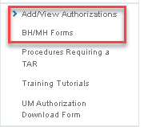
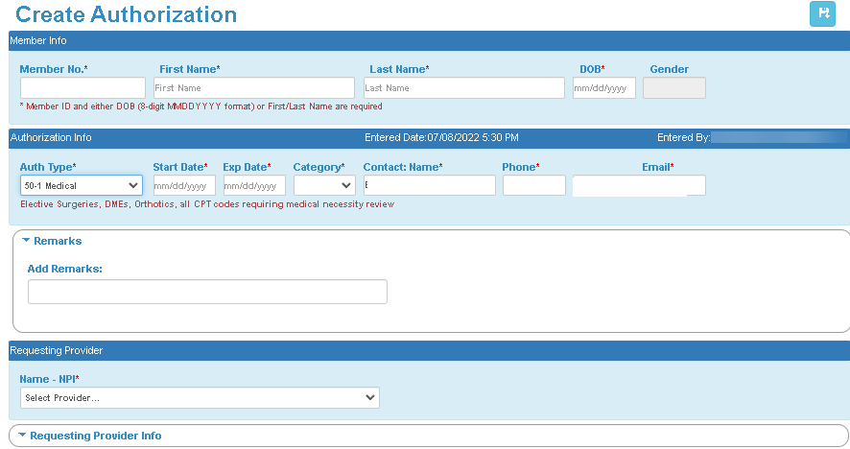
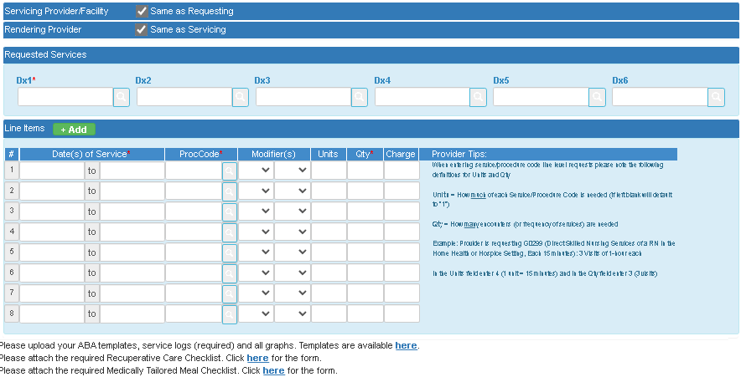
Authorization Requests
Submit authorization requests at least One month prior and no less than 14 days to the expiration of authorization
Updated templates will be available online
Provider Portal>Authorization Module
Behavioral Health Treatment ABA Provider Resources | CenCal Health Insurance Santa Barbara and San Luis Obispo Counties
Provider Only (Restricted) (cencalhealth.org)
Notes:
Martha
Please submit authorization requests no less than 14 days to the expiration date. Please do not submit more than 30 days before the auth ended. If a provider fails to submit at least 14 days before the auth ends, we will be unable to prioritize this request among the other requests submitted timely.
Updated templates will be available on the Provider Webpage as well as a link will be available through the Provider Portal.
Each authorization request must include
A UM Authorization form (if submitted by fax or secure link) with all HCPC codes listed
Please list on separate lines indirect and direct supervision units requested
Service Logs
An updated Treatment Plan
One standardized assessment per review period to triangulate observations with formal data measures
You may use your own template if it meets the minimum requirements
Please submit for approval by 7/25/2022 to Dr. Bowers, Director of Behavioral Health, sbowers@cencalhealth.org

Slide 20
Authorization Requests
Reminder:
Providers can upload these documents within the Provider Portal Authorization Request
Each authorization request must include:
A UM Authorization form (if submitted by fax or secure link) with all HCPC codes listed
Please list on separate lines indirect and direct supervision units requested
Service Logs
An updated Treatment Plan or FBA
One standardized assessment per review period to triangulate observations with formal data measures
You may use your own template if it meets the minimum requirements
Please submit for approval by 7/25/2022 to the Director of Behavioral Health at sbowers@cencalhealth.org
Notes:
Martha
Each authorization request must include
- A UM Authorization form (if submitted by fax or secure link) with all HCPC codes listed
Please list on separate lines indirect and direct supervision units requested
- Service Logs
- An updated Treatment Plan
- One standardized assessment per review period to triangulate observations with formal data measures
- You may use your own template if it meets the minimum requirements
Please submit for approval by 7/25/2022 to Dr. Bowers, Director of Behavioral Health, sbowers@cencalhealth.org

Slide 21
Review the Behavioral Health (ABA) Treatment Benefit & Referrals
FBA & Progress Reports, & Authorizations
Provider Responsibilities
Claims & Billing
Language Interpreter Services
Clara
Clinical Support Associate
SLIDE HEADLINE
Second level of text
Notes:
Clara, thank you. Let’s now review provider responsibilities.

Slide 22
BHT Treatment Services
BHT services must be delivered according to the approved treatment plan.
Parent participation is required and part of CenCal Health’s model of care for BHT services.
Credible studies and industry standards support that parent participation is associated with improved outcomes.
Notes:
Clara
BHT services must be delivered according to the approved treatment plan.
Parent participation is required and part of CenCal’s model of care for BHT services.
Credible studies and industry standards support that parent participation is associated with improved outcomes.
Parent training is a requirement and should be mentioned in the report how this is accomplished.

Slide 23
Non-Covered Services
The following activities are considered non-covered services.
Examples include (but are not limited to):
Training of staff (i.e. Staff Meetings, Team Meetings, IEP Meetings Transitioning Staff)
IEP Meetings to train school staff
Preparation work prior to the provision of services
Accompanying the client to appointments or activities (i.e. shopping, medical appointments)
Except when the identified client has demonstrated a pattern of significant behavioral difficulties during specific activities, in which case the clinician to actively provide treatment, not to just supervise, control, or contain the member/identified client.
Notes:
Clara
The following activities and therapy modalities that do not constitute behavioral assessments and interventions utilizing ABA techniques will considered non-covered services.
Examples include (but are not limited to):
Training of staff (i.e. Staff Meetings, Team Meetings, IEP Meetings, Transitioning Staff)
Preparation work prior to the provision of services
Accompanying the client to appointments or activities (i.e. shopping, medical appointments)
Except when the identified client has demonstrated a pattern of significant behavioral difficulties during specific activities, in which case the clinician to actively provide treatment, not to just supervise, control, or contain the member/identified client.

Slide 24
Non-Covered Services Continued
Transporting the member in lieu of parental transport.
If the member has demonstrated a pattern of significant behavioral difficulties during transport, in which case transport is still provided by the parent, and the clinician is present to actively provide treatment to the member/identified client during transport, not to just supervise, control, or contain the member/identified client.
The provision of services that are part of an Individual Education Plan (IEP) and therefore should be provided by school personnel.
Provider travel time.
Transporting parents or other family members.
Providing services in a camp, spa, resort setting, or non typical setting (i.e. restaurants, movie theaters, Starbucks, zoos, parks, ...etc)
Notes:
Other non covered services include:
Transporting the member/identified client in lieu of parental transport.
If the member/identified patient has demonstrated a pattern of significant behavioral difficulties during transport, in which case transport is still provided by the parent, and the clinician is present to actively provide treatment to the member/identified client during transport, not to just supervise, control, or contain the member/identified client.
Assisting the member with academic work or functioning as a tutor or functioning as an educational aide for the member/identified client in school/daycare or at home or at summer camps.
School or camp must not require ABA services to occur on site for member to attend.
Provision of services that are part of an IEP and therefore should be provided by school personnel.
Provider travel time.
Transporting parents or other family members.
Providing services in a camp/spa/resort setting/non typical setting (restaurants, movie theaters, Starbucks, zoos, parks, ...etc)

Slide 25
BHT Treatment Services
Center-based services may be provided, but some services must still be provided at home.
If all services are to be provided at the center due to extenuating circumstances, please provide justification for the request and include information on the participation of the parents during treatment services
Services may not be provided at a day care unless clinically justified and with day care written permission.
This should be clearly indicated on the treatment plan.
This should be time limited, and goal focused.
Notes:
Clara
Center-based services may be provided, but some services must still be provided at home.
If all services are to be provided at the center due to extenuating circumstances, please provide justification for the request and include information on the participation of the parents during treatment services
Services may not be provided at a day care unless clinically justified and with day care written permission.
Should be clearly indicated on treatment plan.
Should be time limited and goal focused.

Slide 26
BHT Treatment Services
Educational Settings:
Goals and objective related to academic functioning or behaviors uniquely occurring just in school setting will not be covered
FBA requests to assess behavior unique in the school setting will not be covered.
These requests should occur under HO032 for Treatment Plan updates.
Provider must arrange with parent to provide a copy of latest IEP with TAR request.
Please include documentation that the school district has approved the services may take place on school grounds.
Notes:
Clara
Services provided at the educational setting have the following standards:
Goals and objective related to academic functioning or behaviors uniquely occurring just in school setting will not be covered
FBA requests to assess behavior unique in the school setting will not be covered. These requests should occur under HO032 for Treatment Plan updates.
Provider must arrange with parent to provide a copy of latest IEP with TAR request and documentation that the school district has approved that the services may be provided on the school grounds and during school hours.
ABA providers must account for services being provided by LEA, school attendance, or services a Member is eligible for through the LEA in request for treatment hours.
When school is not in session, CenCal may approve service hours that were being provided by LEA. Please submit an IEP showing hours that member was receiving.

Slide 27
BHT Treatment Services Continued
Educational Settings Continued:
ABA providers must account for services being provided by Local Educational Agency.
Providers should also account for school attendance or services a Member is eligible (but not yet receiving) for through the Local Educational Agency when requesting for treatment hours.
When school is not in session, CenCal may approve service hours that were being provided by LEA.
Please submit an IEP showing hours that member was receiving and documentation that Member is not receiving services.
Notes:
Clara
Services provided at the educational setting have the following standards:
Goals and objective related to academic functioning or behaviors uniquely occurring just in school setting will not be covered
FBA requests to assess behavior unique in the school setting will not be covered. These requests should occur under HO032 for Treatment Plan updates.
Provider must arrange with parent to provide a copy of latest IEP with TAR request and documentation that the school district has approved that the services may be provided on the school grounds and during school hours.
ABA providers must account for services being provided by LEA, school attendance, or services a Member is eligible for through the LEA in request for treatment hours.
When school is not in session, CenCal may approve service hours that were being provided by LEA. Please submit an IEP showing hours that member was receiving.

Slide 28
Coordination with other providers
CenCal providers are responsible to obtain a Release of Information from the Member’s PCP and other providers involved with the Member’s Care.
Contact the Member’s pediatrician if Member may benefit from other therapies such as Occupational Therapy, Speech Therapy, or other specialties.
Work closely with all other providers such as the Regional Center and the Local Educational Agency.
Contact CenCal Health’s Behavioral Health Department to consult on complex cases or barriers to service delivery (i.e. homelessness, unsafe home-environment, lack of staff, etc.)
Notes:
Clara
CenCal providers are responsible to coordinate care for members by Contacting member’s pediatrician if member may benefit from other therapies such as Occupational Therapy, Speech Therapy, or comprehensive medical case management.
Working closely with all other providers such as the Regional Center and the Local Education Agency.
Contacting the CenCal Health Behavioral Health Department to consult on complex cases or barriers to service delivery i.e. homelessness, unsafe home-environment, lack of staff, etc.
I’ll now hand it over to Martha to discuss direct supervision.

Slide 29
Direct Supervision
Direct supervision can be requested at the rate of 2 hours for every 10 hours of direct 1:1 treatment.
H0032 can be used for a variety of supervision activities such as (not limited to):
Assessment Updates
Developing treatment goals
H0031 are allowed at the initiation of services by new provider.
If a Member’s treatment is disrupted for 4 or more months, another FBA will be authorized.
Notes:
Martha
Per BACB Guidelines , “Health Plan Coverage of Applied Behavior Analysis Treatment for Autism Spectrum Disorder”: Clinical management and case supervision activities can be described as those that involve contact with the client or caregivers (direct) and those that do not (indirect). Some supervision activities include assessments, developing treatment goals.
Direct Supervision can be requested at the rate of 2 hours for every 10 hours of direct 1:1 treatment.
H0032 can be used for a variety of supervision activities such as:
Assessments
Developing treatment goals
H0031 are allowed at the initiation of services by new provider.
If a Member’s treatment is disrupted for 4 or more months, another FBA will be authorized.

Slide 30
Indirect Supervision
Providers can request up to 10 hours of indirect supervision an authorization
Requests should be proportional to weekly treatment hours and goals.
Please request on a separate line code from direct supervision.
Indirect Supervision can be the BCBA only for:
In-office functional analysis and skills assessment
In-office development of goals/objectives and behavioral intervention plans/reports
In-office direct staff summary notes
In office clinical meetings with both paraprofessionals and parents present
Notes:
Martha
Providers may request up to 10 hours of indirect supervision. Indirect supervision can only be completed by a BCBA
Providers can request up to 10 hours of indirect supervision an authorization
Requests should be proportional to weekly treatment hours and goals.
Please request on a separate line code from direct supervision.
Indirect Supervision can be used for:
In-office functional analysis and skills assessment
In-office development of goals/objectives and behavioral intervention plans/reports
In-office direct staff summary notes
In office clinical meetings with both paraprofessionals and parents present

Slide 31
HCPCS Code Reminders
S5111
Requested by session and not hourly
Service limit is 2 a day
Requests should be aligned with goals
Please indicate how parent training will be utilized to meet goals in treatment plans
H2019
Clinical Care Guidelines state that most pediatric members will benefit up to 25 hours a week of ABA
Requests of more than 25 hours, requires clinical justification of enhanced ABA care.
Notes:
Martha
Please see the following HCPCS Code Reminders
S5111
Requested by session and not hourly
Service limit is 2 a day
Requests should be aligned with goals
Please indicate how parent training will be utilized to meet goals in treatment plans
H2019
Clinical Care Guidelines state that most pediatric members will benefit up to 25 hours a week of ABA
Requests of more than 25 hours, requires clinical justification of enhanced ABA care. Please complete the required section on the FBA or 6 month Progress Report templates.
Provide example of S5111 (session can mean it is only 15mins long…or it could be 2 hours long, it’s all seen as a “session”
Now I will transition to Andy to review reminders.

Slide 32
Modifiers
NEW Authorizations Starting 8/15/2022 | Open Authorizations as of 8/15/2022
Submit H0031 & H0032 in 15 minutes=1 unit
Do not include Modifiers on Authorizations
Include Modifiers on all claims
Notes:
Martha
Starting 8/1/22, providers will no longer need to indicate modifiers on the authorization requests
Please do not submit addendums on any active authorizations
Please continue to submit modifiers with claims
15 minute increments for HCPCS codes H0031 & H0032
For all OPEN authorizations:

Slide 33
Reminders
Goals should be objective and developmentally appropriate
Do not include academic/educational goals
Service logs are required with every submission
Progress Reports must include a transition plan for Members aging out of the benefit
We have included a new section in the CenCal templates that needs to be filled out
Submit denial letters for Members who have Other Healthcare Coverage with every submission
Denial letters are good for one year from the date of the letter
To obtain a denial letter, please submit an authorization request to the primary insurance
Notes:
Andy
Goals should be objective and developmentally appropriate (Do not include academic/educational goals)
Service logs are required with every submission
Progress Reports must include a transition plan for members aging out of the benefit
We have included a new section in the CenCal templates that needs to be filled out (discharge criteria)
Submit denial letters for members who have OHC every submission
Good for one year from date of letter
Must submit an authorization request to primary insurance to obtain a denial (Member can not call to obtain)

Slide 34
Graduation and Fading of Services
BHT services must be faded gradually and systematically over time
BHT providers will complete a transition plan as part of FBA/Progress Report and submit to the CenCal Behavioral Health Department.
Please coordinate care with TCRC Case Workers
Please develop a transition plan with Member’s family.
Members who turn 20 while receiving BHT services, must commence fading of services in order to graduate prior to their 21st birthday.
Notes:
Andy
CenCal recommends transition plan needs to start occurring at age 19 to ensure smooth transition
BHT services must be faded gradually and systematically over time as the member meets treatment goals or the member has met the maximum benefit of services.
BHT providers will complete a discharge summary and submit to the CenCal Behavioral Health Department.
Please coordinate care with TCRC Case Workers
Please develop a transition plan with Member’s family.
Members who turn 20 while receiving BHT services, must commence fading of services in order to graduate prior to their 21st birthday.
BHT providers will document the plan fading of services and care coordination for the Member post-discharge on Progress Reports.

Slide 35
No-Shows, Cancellations & Other Issues
Please contact the Behavioral Health Call Center to request Behavioral Health Navigator assistance.
Behavioral Health Navigators support Providers & Members by:
Providing Member Education to support a positive provider and member relationship.
Identify barriers to engaging in care and support member to problem solve
Support health literacy
Assist with transportation and other community resources
Notes:
Andy
Member no shows, cancellations and behavioral issues can occur at times.
CenCal Behavioral Health Department is ready to support providers.
Please contact the Behavioral Health Call Center to request Behavioral Health Navigator assistance.
Behavioral Health Navigators support Providers & Members by:
Providing Member Education to support a positive provider and member relationship.
Identify barriers to engaging in care and support member to problem solve
Support health literacy
Assist with transportation and other community resources

Slide 36
Requests for 2:1 Staffing
Requests for two or more staffing may be covered when one or more non-redirectable destructive behaviors that pose significant risk of harm to the individual or others are present and an appropriate intervention has been chosen and planned.
The request must include the following:
Description of the behaviors that pose a significant risk of harm to the Member or others
2. Description of how the plan is to expose the Member to social or environmental stimuli associated with the destructive behavioral and
3. Description of how the assessment will be conducted in a setting conducive to the safety of the Member and other individuals who may be present and
4. The total hours requested should be in proportion to the treatment goals and overall hours requested per week.
Notes:
Andy
CenCal understands that at times member’s behavior warrants additional safety to support the member and staff safety.
Requests for two or more technicians assisting a physician or other qualified health professional may be covered when one or more non-redirectable destructive behaviors that pose significant risk of harm to the individual or others are present and an appropriate intervention has been chosen and planned.
The request must include the following:
Description of the behaviors that pose significant risk of harm to the individual or others and
Description of how the plan is to expose the individual to social or environmental stimuli associated with the destructive behavioral and
Description of how the assessment will be conducted in a setting conducive to the safety of the individual and other individual who may be present, including but not limited to the physician, other qualified health care professional, or technician.
The total hours requested should be comprised in proportion to the treatment goals and overall hours requested per week. If additional treatment time is requested a rationale must be provided with the request describing the specific situation that warrants additional time.

Slide 37
Contact Us - Behavioral Health Dept.
Behavioral Heath Care Coordination Center
Member line 1-877-814-1861
Behavioral Heath Care Coordination
Provider Line (805) 562-1699
BH Department Fax Line (805) 682-5117
BH Secure Link https://gateway.cencalhealth.org/form/bh
CenCal Health Pediatric Case Management (805) 562-1082
Notes:
Andy
Here are the some important numbers.
Just a reminder staff extensions are not for member user and please do not provide staff extensions

Slide 38
Citations
BACB Guidelines, “Health Plan Coverage of Applied Behavior Analysis Treatment for Autism Spectrum Disorder”:
https://asbg.org/wp-content/uploads/2014/01/ABA_Guidelines_for_ASD.pdf

Slide 39
Lucy
Claims Provider Data Configuration Analyst
Claims & Billing Overview
Lucy
Claims Provider Data Configuration Analyst
Billing Codes
Modifiers
Claims Timelines
Claims Corrections
Common Denials
Provider Portal Denial Overview

Slide 40
Billing Codes
Effective for Dates of Service on or after 08/15/2022 HCPCS Codes H0031 and H0032 have been changed to 15-minute incremental billing.
For Example: quantity of 1 = 15 minutes, quantity of 2 units = 30 minutes, quantity units = 45 minutes etc.
For Dates of Service prior to 08/15/2021 please continue to bill H0031 and H0032 per hour session.
Continue use of HCPCS codes as they currently are:
H2014-15 minutes
H2019-15 minutes
S5111-per session
T1014 - 1 minute
Notes:
Talking notes: Please keep in mind that claims for DOS prior to 08/15/2022 will need to continue to be billed in hourly sessions. We recommend that you bill using your usual customary charges for services rendered. If your bill charges are lower that what your contracted rate, we will only pay up to bill charges.

Slide 41
Modifiers
Continue to use all Modifiers as you currently are:
HO for QASP Professional/BCaBA
HM for QASP Paraprofessional/RBT
Billing Tips:
When billing services for BCBA (QASP, QAS Provider, QAS Level 3) a modifier is not required
When billing services for ABCBA/BCaBA (QASPRO, QAS Professional, QAS Level 2) use modifier HO
When billing services for RBT (QASPARA, QAS Paraprofessional, QAS Level 1) use modifier HM
Notes:
Notes:

Slide 42
Claim Timelines
Original (or initial) claim must be received by CenCal Health within six months following the month in which services were rendered or the following payment reductions may apply:
Claims received during the 7th,8th or 9th month after the month of service will have final payment reduced by 25%
Claims received during the 10th,11th or 12th month of service will have final payment reduced by 50%
Claims received after the 12th month following the month of service will be denied
There are exceptions to these billing limits. These can be found in the State of California’s Medi-Cal Manual CMS-1500 Submission and Timeliness Instructions (cms sub)
Notes:
Notes: We have been receiving inquiries that Holman did not process claims for in 2021, please keep in mind the claim timelines will still apply.

Slide 43
Claims Follow Up and Corrections
Please submit corrections to previously billed claims by submitting the corrected claim electronically or by making the correction on our website (if the claim has not appeared on an EOP.)
CenCal Health offers (3) three easy and convenient ways to bill:
CenCal Health Provider Portal
Electronic
Paper Claims
CenCal Health
PO Box 948
Goleta, CA 93116-0948
Notes:
Notes** We have been receiving inquiries that Holman did not process claims for in 2021, please keep in mind the claim timelines will still apply.

Slide 44
Common Denials
3R (Denial Description - MISSING EXPLANATION OF BENEFIT (EOB) AND/OR REASON FOR NON-PAYMENT FROM OTHER HEALTH CARRIER)
KH (Denial Description - ACCESS OHC DATA THRU AEVS AT (800)427-1295 OR AT https://www.medical.ca.gov/Eligibility/Login.asp)
BILLING TIP: These denials happen when the member has Primary Insurance. If you receive a denial letter from Primary Insurance that states ABA services are not covered, please include these remarks on the claim (via portal or electronically) and send a copy a of the denial letter for our records.
Notes:
Talking points ** The Primary OHC denial letter is good for a year.

Slide 45
Common Denials
93 ( Denial Description - SERVICES PROCESSED ON ANOTHER CLAIM)
BILLING TIP: This denial happens when the claim has been previously submitted for the same member, same date of service. If the member has been seen multiple times on the same day, please add remarks on your claim with the different appointment times. If this information is not provided claims will remain denied
9R (Denial Description -SUPERVISING PHYSICIANS NPI IS REQUIRED):
BILLING TIP: This denial happens when you submitted a rendering provider on the claim that is non payable. You should submit your claim using the supervising provider and In remarks add the first and last name, the title of the person that is rendering the services.
Notes:
Talking points ** for explain code 93 - If you have submitted a claim to Holman that was previously denied, please resubmit the claims to us if it’s still within the timelines.
Talking points ** for explain code 9R -

Slide 46
Common Denials
9E ( Denial Description -RENDERING PROVIDER # IS MISSING OR INVALID - CONTACT PROVIDER SERVICES)
94 ( Denial Description - RENDERING NUMBER INVALID, CONTACT PROVIDER SERVICES DEPARTMENT 1-800-421-2560 EXT 1676)
BILLING TIP: This denial happens when the rendering provider is not in our system and/or associated to the Group. Please ensure that you are communicating with your Provider Representative if you have added new rendering providers to your roster.
Notes:
Talking points ***

Slide 47
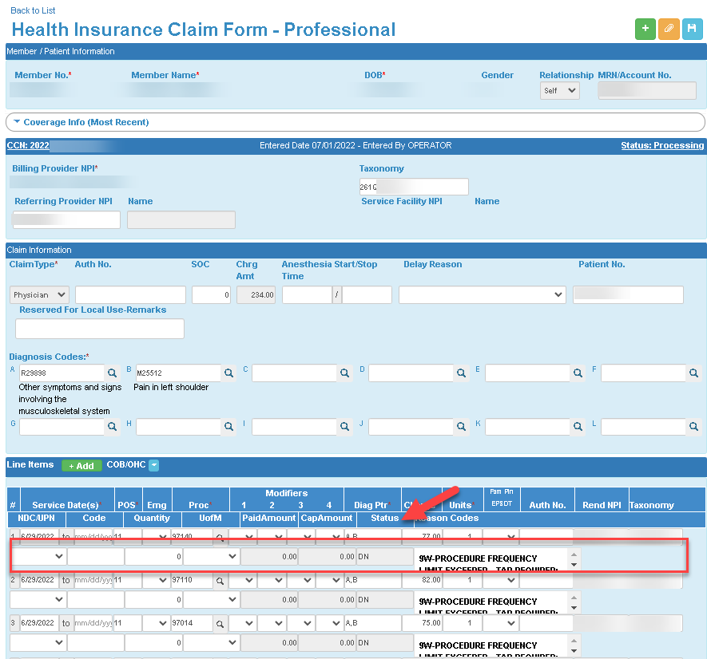
How to identify Denials in the Portal
Notes:
Now that we reviewed these common denials, Im going to show you how to identify them within the Claims module within the Provider Portal so you can make corrections.
Once you are in the Claims module, you can filter by going to the ‘EOB Status’ drop down, and click on ‘Provider Review Req’. These are claims that have not been processed by our Claims Department and/or finalized on your EOP (explanation of payment) . Then <Click animation arrow> click the blue looking glass to filter those claims that need your review which will be located on the main list below. Once identified <Click animation arrow> please click on the CCN number to view your submitted claim in more detail.
<Click animation > Here is an example of a submitted claim with denied line items located below. Based on the reason code, please move forward with making your edits. Also here is a sample of the ‘Remarks’ box <Click animation > where you can add your Primary Insurance details that states ABA services are not covered that we just presented.
Now that you have made your edits, you can upload documents (maybe your primary insurance denial letter) here by clicking on the orange paper clip icon <Click animation >, and then click the save icon <Click animation >

Slide 48
Review the Behavioral Health (ABA) Treatment Benefit & Referrals
FBA & Progress Reports, & Authorizations
Provider Responsibilities
Claims & Billing
Language Interpreter Services
Elizabeth
Senior Provider Services Trainer

Slide 49
Interpreting Services
CenCal Health ensures interpreting services to all eligible CenCal Health members:
Interpreting is available in over 200 languages free of charge
Phone/Video interpreting is not required. Face-to-Face is available for ASL members
Phone Interpreters are available 24 hours a day, 7days a week
CenCal Health recognizes that face-to-face interpreting is an important option for interaction and understanding complex situations
Notes:
To assist in members care, CenCal Health offers interpreter services with our Certified Language Interpreter (CLI) operating vendor and offers 200 interpreting languages. Again, this is an amazing benefit for our LEP members.
We offer telephonic, and our new video remote interpreting service options 24 hours a day 7 days a week, and free of cost to providers and eligible members. When utilizing this services please document a member’s request or need for interpreter services in their primary language within their chart notes, and make it easily accessible for your staff to reference during visits. It’s the responsibility of the provider to request interpreter services, not the Member and appointments should remain scheduled
If a member declines or refuses interpreter services, document this in the member’s medical chart and try to offer handouts, discharge paperwork and health education materials in the member’s primary language.
Also please ensure that bilingual staff that provide interpreter services within your office have been evaluated and are capable of health care interpreting. CenCal Health discourages providers from using family members or any unqualified personnel as interpreters.

Slide 50
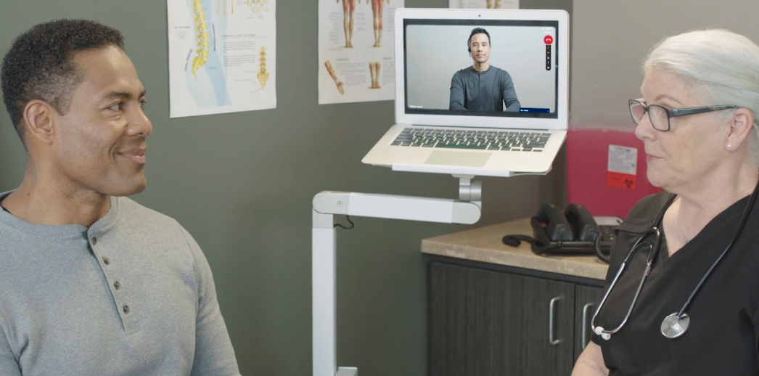
Phone & Video Remote Interpreter Service
Follow these easy steps to connect to a telephonic interpreter:
Follow these easy steps to connect to a video remote interpreter:
VRI Web Address: cencalhp.cli-video.com
VRI Access Code: 48cencalhp
Notes:
<Anna read content below>
To access the phone interpreting services:
- Dial the toll-free number: 1 (800) 225-5254
- Provide operator customer code: 48CEN
- Indicate to operator that you are calling on behalf of a CenCal Health provider
- Request Language needed
- Provide your phone number, provider’s last name, NPI #, CenCal Health member ID and patient name
Or Providers have the ability to access the video interpreter service with the web address on the screen, and entering in the VRI code 48cencalhp.
Key tips to remember:
Video for American Sign Language (ASL) is available anytime for all providers
All providers will need to supply their own device (laptop, tablet, phone etc.) for these services. CenCal Health will not provide these devices
Do not use a member’s phone for video or phone interpreting services
Do not give members your provider login or password for this service shown here on the screen
And last we highly recommend that you do not pre-schedule video interpreting services in advance as appointments may change

Slide 51
www.cencalhealth.org/providers/cultural-linguistic-resources/cultural-competency-and-health-literacy/
Notes:
<Anna>
To learn more about these resources please go to our Cultural Competency, Health Literacy website page linked here on the screen.

Slide 52
Time for Q&A with our CenCal Health Team
Type your questions here
Notes:
<All to participate, with Gregg having access to view questions coming in and read them to the panel for them to answer>
If we do not get to your question, someone from our team we will reach out to you directly via email.

Slide 53
Need Additional Help or Want to Learn More?
Provider Services Representatives
Contracting/Onboarding
psrgroup@cencalhealth.org
(805) 562-1676
provideronboarding@cencalhealth.org
Provider Portal Access/Issues/Education
webmaster@cencalhealth.org
www.cencalhealth.org/providers/provider-portal/
Claims & Billing
Claims Support & Claims Training
(805) 562-1083 or (800) 421-2560 ext. 1083
cencalclaims@cencalhealth.og
www.cencalhealth.org/providers/claims/
Notes:
<Jamie>

Slide 54
Notes:
This concludes Behavioral Health (ABA) Treatment Overview, Authorization & Claims Training . We look forward to working with you and continuing our collaboration so our members receive the best quality of care. Please take a moment and fill out our post training survey after we end here today so we can continue to provide exceptional education and resources for our provider network.
You will receive a copy of these slides and the recording to this event along with handouts in the next couple of days.
Have a great day.

